Slide 1
Digital Design & Computer Arch. Lecture 15a: Out-of-Order Execution
Prof. Onur Mutlu
ETH Zürich
Spring 2020
9 April 2020

Slide 2
Required Readings
This week
Out-of-order execution
H&H, Chapter 7.8-7.9
Smith and Sohi, “The Microarchitecture of Superscalar Processors,” Proceedings of the IEEE, 1995
More advanced pipelining
Interrupt and exception handling
Out-of-order and superscalar execution concepts
Optional
Kessler, “The Alpha 21264 Microprocessor,” IEEE Micro 1999.
Next Week
McFarling, “Combining Branch Predictors,” DEC WRL Technical Report, 1993.

Slide 3
Agenda for Today & Next Few Lectures
Single-cycle Microarchitectures
Multi-cycle and Microprogrammed Microarchitectures
Pipelining
Issues in Pipelining: Control & Data Dependence Handling, State Maintenance and Recovery, …
Out-of-Order Execution
Other Execution Paradigms

Slide 4
Review: In-Order Pipeline with Reorder Buffer
Decode (D): Access regfile/ROB, allocate entry in ROB, check if instruction can execute, if so dispatch instruction (send to functional unit)
Execute (E): Instructions can complete out-of-order
Completion (R): Write result to reorder buffer
Retirement/Commit (W): Check for exceptions; if none, write result to architectural register file or memory; else, flush pipeline and start from exception handler
In-order dispatch/execution, out-of-order completion, in-order retirement
E
Integer add
Integer mul
E
E
E
E
R
W
F
D
FP mul
E
E
E
E
E
E
E
E
R
. . .
E
E
E
E
E
E
E
E
Load/store

Slide 5
Recall: Data Dependence Types
True (flow) dependence
r₃ ← r₁ op r₂ Read-after-Write
r₅ ← r₃ op r₄ (RAW) -- True
Anti dependence
r₃ ← r₁ op r₂ Write-after-Read
r₁ ← r₄ op r₅ (WAR) -- Anti
Output-dependence
r₃ ← r₁ op r₂ Write-after-Write
r₅ ← r₃ op r₄ (WAW) -- Output
r₃ ← r₆ op r₇

Slide 6
Remember: Register Renaming with a Reorder Buffer
Output and anti dependencies are not true dependencies
WHY? The same register refers to values that have nothing to do with each other
They exist due to lack of register ID’s (i.e. names) in the ISA
The register ID is renamed to the reorder buffer entry that will hold the register’s value
Register ID → ROB entry ID
Architectural register ID → Physical register ID
After renaming, ROB entry ID used to refer to the register
This eliminates anti and output dependencies
Gives the illusion that there are a large number of registers

Slide 7
Out-of-Order Execution (Dynamic Instruction Scheduling)

Slide 8
An In-order Pipeline
Integer add
E
Integer mul
E
E
E
E
R
W
F
D
FP mul
E
E
E
E
E
E
E
E
. . .
E
E
E
E
E
E
E
E
Cache miss
Dispatch: Act of sending an instruction to a functional unit
Renaming with ROB eliminates stalls due to false dependencies
Problem: A true data dependency stalls dispatch of younger instructions into functional (execution) units

Slide 9
Can We Do Better?
What do the following two pieces of code have in common (with respect to execution in the previous design)?
Answer: First ADD stalls the whole pipeline!
ADD cannot dispatch because its source registers unavailable
Later independent instructions cannot get executed
How are the above code portions different?
Answer: Load latency is variable (unknown until runtime)
What does this affect? Think compiler vs. microarchitecture
IMUL R3 ← R1, R2
ADD R3 ← R3, R1
ADD R4 ← R6, R7
IMUL R5 ← R6, R8
ADD R7 ← R9, R9
LD R3 ← R1 (0)
ADD R3 ← R3, R1
ADD R4 ← R6, R7
IMUL R5 ← R6, R8
ADD R7 ← R9, R9

Slide 10
Preventing Dispatch Stalls
Problem: in-order dispatch (scheduling, or execution)
Solution: out-of-order dispatch (scheduling, or execution)
Actually, we have seen the basic idea before:
Dataflow: “fire” an instruction only when its inputs are ready
We will use similar principles, but not expose it in the ISA
Aside: Any other way to prevent dispatch stalls?
1. Compile-time instruction scheduling/reordering
2. Value prediction
3. Fine-grained multithreading

Slide 11
Out-of-order Execution (Dynamic Scheduling)
Idea: Move the dependent instructions out of the way of independent ones (s.t. independent ones can execute)
Rest areas for dependent instructions: Reservation stations
Monitor the source “values” of each instruction in the resting area
When all source “values” of an instruction are available, “fire” (i.e. dispatch) the instruction
Instructions dispatched in dataflow (not control-flow) order
Benefit:
Latency tolerance: Allows independent instructions to execute and complete in the presence of a long-latency operation

Slide 12
In-order vs. Out-of-order Dispatch
In order dispatch + precise exceptions:
Out-of-order dispatch + precise exceptions:
16 vs. 12 cycles
F
D
E
E
E
E
R
W
IMUL R3 ← R1, R2
ADD R3 ← R3, R1
ADD R1 ← R6, R7
IMUL R5 ← R6, R8
ADD R7 ← R3, R5
F
D
STALL
E
R
W
F
STALL
D
E
R
W
F
D
E
E
E
E
E
R
W
F
D
STALL
E
R
W
F
D
E
E
E
E
R
W
F
D
WAIT
E
R
W
F
D
E
R
W
F
D
E
E
E
E
R
W
F
D
WAIT
E
R
W

Slide 13
Enabling OoO Execution
1. Need to link the consumer of a value to the producer
Register renaming: Associate a “tag” with each data value
2. Need to buffer instructions until they are ready to execute
Insert instruction into reservation stations after renaming
3. Instructions need to keep track of readiness of source values
Broadcast the “tag” when the value is produced
Instructions compare their “source tags” to the broadcast tag → if match, source value becomes ready
4. When all source values of an instruction are ready, need to dispatch the instruction to its functional unit (FU)
Instruction wakes up if all sources are ready
If multiple instructions are awake, need to select one per FU

Slide 14
Tomasulo’s Algorithm for OoO Execution
OoO with register renaming invented by Robert Tomasulo
Used in IBM 360/91 Floating Point Units
Read: Tomasulo, “An Efficient Algorithm for Exploiting Multiple Arithmetic Units,” IBM Journal of R&D, Jan. 1967.
What is the major difference today?
Precise exceptions
Provided by
Patt, Hwu, Shebanow, “HPS, a new microarchitecture: rationale and introduction,” MICRO 1985.
Patt et al., “Critical issues regarding HPS, a high performance microarchitecture,” MICRO 1985.
OoO variants are used in most high-performance processors
Initially in Intel Pentium Pro, AMD K5
Alpha 21264, MIPS R10000, IBM POWER5, IBM z196, Oracle UltraSPARC T4, ARM Cortex A15

Slide 15
Two Humps in a Modern Pipeline
Hump 1: Reservation stations (scheduling window)
Hump 2: Reordering (reorder buffer, aka instruction window or active window)
TAG and VALUE Broadcast Bus
S
C
H
E
D
U
L
E
R
E
O
R
D
E
R
E
Integer add
Integer mul
F
D
E
E
E
E
W
FP mul
E
E
E
E
E
E
E
E
. . .
E
E
E
E
E
E
E
E
Load/store
in order
out of order
in order

Slide 16
Two Humps in a Modern Pipeline
Hump 1: Reservation stations (scheduling window)
Hump 2: Reordering (reorder buffer, aka instruction window or active window)
TAG and VALUE Broadcast Bus
S
C
H
E
D
U
L
E
R
E
O
R
D
E
R
E
Integer add
Integer mul
F
D
E
E
E
E
W
FP mul
E
E
E
E
E
E
E
E
. . .
E
E
E
E
E
E
E
E
Load/store
in order
out of order
in order
Photo credit: http://true-wildlife.blogspot.ch/2010/10/bactrian-camel.html

Slide 17
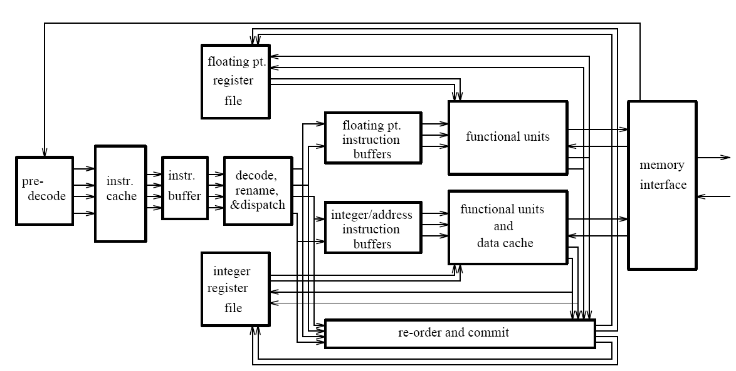
General Organization of an OOO Processor
Smith and Sohi, “The Microarchitecture of Superscalar Processors,” Proc. IEEE, Dec. 1995.

Slide 18
Tomasulo’s Machine: IBM 360/91
FP registers
from memory
from instruction unit
load
buffers
store buffers
operation bus
reservation
stations
to memory
FP FU
FP FU
Common data bus

Slide 19
Recall Once More: Register Renaming
Output and anti dependencies are not true dependencies
WHY? The same register refers to values that have nothing to do with each other
They exist because not enough register ID’s (i.e. names) in the ISA
The register ID is renamed to the reservation station entry that will hold the register’s value
Register ID → RS entry ID
Architectural register ID → Physical register ID
After renaming, RS entry ID used to refer to the register
This eliminates anti- and output- dependencies
Approximates the performance effect of a large number of registers even though ISA has a small number

Slide 20
Tomasulo’s Algorithm: Renaming
Register rename table (register alias table)
tag
value
valid?
R0
1
R1
1
R2
1
R3
1
R4
1
R5
1
R6
1
R7
1
R8
1
R9
1

Slide 21
Tomasulo’s Algorithm
If reservation station available before renaming
Instruction + renamed operands (source value/tag) inserted into the reservation station
Only rename if reservation station is available
Else stall
While in reservation station, each instruction:
Watches common data bus (CDB) for tag of its sources
When tag seen, grab value for the source and keep it in the reservation station
When both operands available, instruction ready to be dispatched
Dispatch instruction to the Functional Unit when instruction is ready
After instruction finishes in the Functional Unit
Arbitrate for CDB
Put tagged value onto CDB (tag broadcast)
Register file is connected to the CDB
Register contains a tag indicating the latest writer to the register
If the tag in the register file matches the broadcast tag, write broadcast value into register (and set valid bit)
Reclaim rename tag
no valid copy of tag in system!

Slide 22
An Exercise
Assume ADD (4 cycle execute), MUL (6 cycle execute)
Assume one adder and one multiplier
How many cycles
in a non-pipelined machine
in an in-order-dispatch pipelined machine with imprecise exceptions (no forwarding and full forwarding)
in an out-of-order dispatch pipelined machine imprecise exceptions (full forwarding)
MUL R3 ← R1, R2
ADD R5 ← R3, R4
ADD R7 ← R2, R6
ADD R10 ← R8, R9
MUL R11 ← R7, R10
ADD R5 ← R5, R11
F
D
E
W

Slide 23
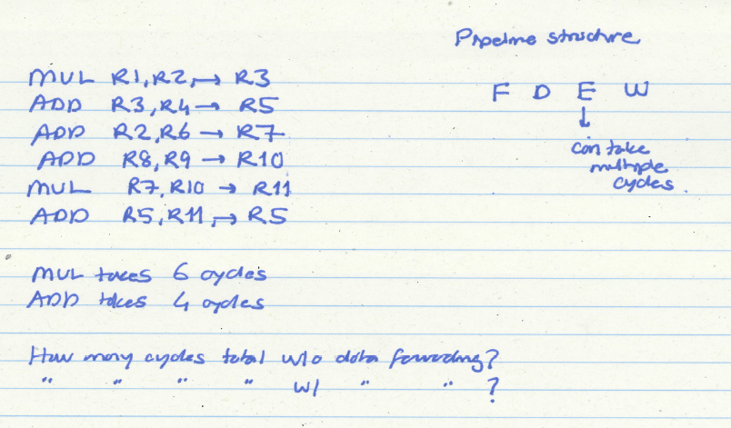
Exercise Continued

Slide 24
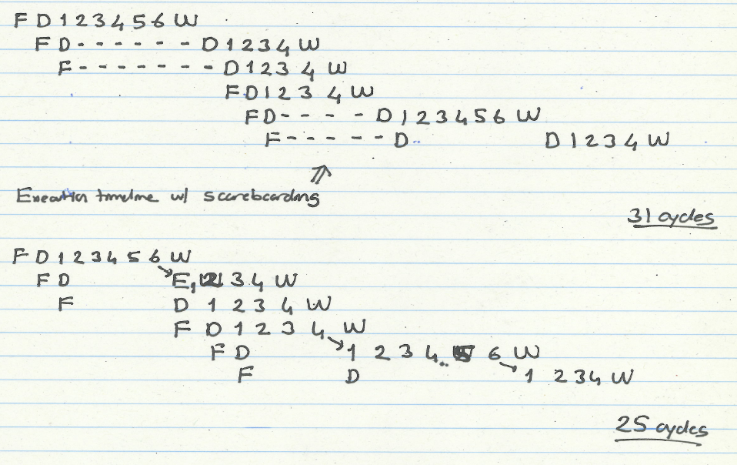
Exercise Continued

Slide 25
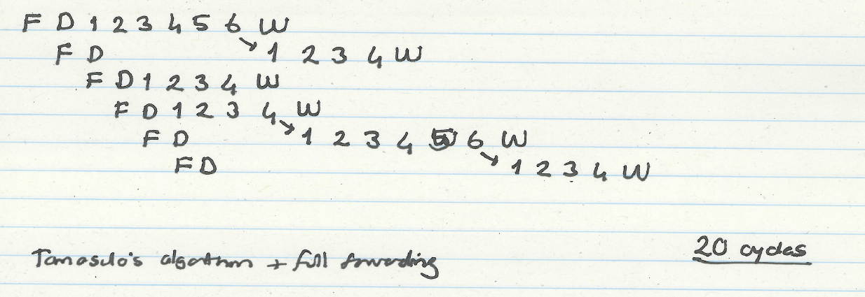
Exercise Continued
MUL R3 ← R1, R2
ADD R5 ← R3, R4
ADD R7 ← R2, R6
ADD R10 ← R8, R9
MUL R11 ← R7, R10
ADD R5 ← R5, R11

Slide 26
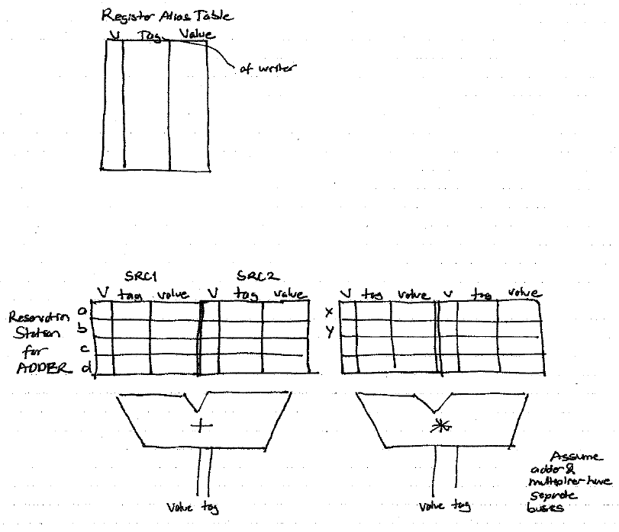
How It Works

Slide 27
Our First OoO Machine Simulation
Program We Will Simulate
MUL | R1, R2 | → | R3
ADD | R3, R4 | → | R5
ADD | R2, R6 | → | R7
ADD | R8, R9 | → | R10
MUL | R7, R10 | → | R11
ADD | R5, R11 | → | R5
Initially:
RS’s are all Invalid (Empty)
All Registers are Valid
RS for ADD Unit
RS for MUL Unit
Register | Valid | Tag | Value
R1 | 1 |  | 1
R2 | 1 |  | 2
R3 | 1 |  | 3
R4 | 1 |  | 4
R5 | 1 |  | 5
R6 | 1 |  | 6
R7 | 1 |  | 7
R8 | 1 |  | 8
R9 | 1 |  | 9
R10 | 1 |  | 10
R11 | 1 |  | 11
 | Source 1 |  |  | Source 2
 | V | Tag | Value | V | Tag | Value
a
b
c
d
 | Source 1 |  |  | Source 2
 | V | Tag | Value | V | Tag | Value
x
y
z
t
+
∗
Tag
Value
Tag
Value
Register Alias Table
ADD and MUL Execution Units
have separate buses

Slide 28
Cycle 0
Cycle
MUL | R1, R2 | → | R3
ADD | R3, R4 | → | R5
ADD | R2, R6 | → | R7
ADD | R8, R9 | → | R10
MUL | R7, R10 | → | R11
ADD | R5, R11 | → | R5
Register | Valid | Tag | Value
R1 | 1 |  | 1
R2 | 1 |  | 2
R3 | 1 |  | 3
R4 | 1 |  | 4
R5 | 1 |  | 5
R6 | 1 |  | 6
R7 | 1 |  | 7
R8 | 1 |  | 8
R9 | 1 |  | 9
R10 | 1 |  | 10
R11 | 1 |  | 11
 | Source 1 |  |  | Source 2
 | V | Tag | Value | V | Tag | Value
a
b
c
d
 | Source 1 |  |  | Source 2
 | V | Tag | Value | V | Tag | Value
x
y
z
t
+
∗

Slide 29
Cycle 1
Cycle
1
MUL | R1, R2 | → | R3
ADD | R3, R4 | → | R5
ADD | R2, R6 | → | R7
ADD | R8, R9 | → | R10
MUL | R7, R10 | → | R11
ADD | R5, R11 | → | R5
F
Register | Valid | Tag | Value
R1 | 1 |  | 1
R2 | 1 |  | 2
R3 | 1 |  | 3
R4 | 1 |  | 4
R5 | 1 |  | 5
R6 | 1 |  | 6
R7 | 1 |  | 7
R8 | 1 |  | 8
R9 | 1 |  | 9
R10 | 1 |  | 10
R11 | 1 |  | 11
 | Source 1 |  |  | Source 2
 | V | Tag | Value | V | Tag | Value
a
b
c
d
 | Source 1 |  |  | Source 2
 | V | Tag | Value | V | Tag | Value
x
y
z
t
+
∗

Slide 30
Cycle 2
MUL gets decoded and allocated into RS x
Step 1: Check if reservation station available. Yes: x
Cycle
1
2
Step 2: Access the Register Alias Table
MUL | R1, R2 | → | R3
ADD | R3, R4 | → | R5
ADD | R2, R6 | → | R7
ADD | R8, R9 | → | R10
MUL | R7, R10 | → | R11
ADD | R5, R11 | → | R5
F
D
Step 3: Put source registers into reservation station x.
F
Step 4: Rename destination register R3 → x
R3 is now renamed to x.
Its new value will produced by the reservation station
that is identified by tag x.
Register | Valid | Tag | Value
R1 | 1 |  | 1
R2 | 1 |  | 2
R3 | 1 |  | 3
R4 | 1 |  | 4
R5 | 1 |  | 5
R6 | 1 |  | 6
R7 | 1 |  | 7
R8 | 1 |  | 8
R9 | 1 |  | 9
R10 | 1 |  | 10
R11 | 1 |  | 11
1
1
 | Source 1 |  |  | Source 2
 | V | Tag | Value | V | Tag | Value
a
b
c
d
 | Source 1 |  |  | Source 2
 | V | Tag | Value | V | Tag | Value
x
y
z
t
1
2
0
x
~
~
+
∗
MUL in RS x is ready to execute in the next cycle!

Slide 31

Cycle 3
1. MUL in RS x starts executing
2. ADD gets decoded and allocated into RS a
Cycle
1
2
3
Check readiness (Both sources ready?) → Wakeup
MUL | R1, R2 | → | R3
ADD | R3, R4 | → | R5
ADD | R2, R6 | → | R7
ADD | R8, R9 | → | R10
MUL | R7, R10 | → | R11
ADD | R5, R11 | → | R5
F
D
E₁
Ready → Dispatch the instruction to the MUL unit
F
D
Same Steps 1-4 for ADD… Rename R5 → a
F
Register | Valid | Tag | Value
R1 | 1 |  | 1
R2 | 1 |  | 2
R3 | 0 | x
R4 | 1 |  | 4
R5 | 1 |  | 5
R6 | 1 |  | 6
R7 | 1 |  | 7
R8 | 1 |  | 8
R9 | 1 |  | 9
R10 | 1 |  | 10
R11 | 1 |  | 11
 | Source 1 |  |  | Source 2
 | V | Tag | Value | V | Tag | Value
a
b
c
d
 | Source 1 |  |  | Source 2
 | V | Tag | Value | V | Tag | Value
x | 1 | ~ | 1 | 1 | ~ | 2
y
z
t
0
x
~
1
4
0
a
+
∗
6
Cycles
ADD in RS a cannot execute in the next cycle: one source is not valid

Slide 32
Cycle 4
Cycle
1
2
3
4
ADD in RS a waits because one source is not valid.
MUL | R1, R2 | → | R3
ADD | R3, R4 | → | R5
ADD | R2, R6 | → | R7
ADD | R8, R9 | → | R10
MUL | R7, R10 | → | R11
ADD | R5, R11 | → | R5
F
D
E₁
E₂
Rename R7 → b
F
D
-
F
D
F
Register | Valid | Tag | Value
R1 | 1 |  | 1
R2 | 1 |  | 2
R3 | 0 | x
R4 | 1 |  | 4
R5 | 0 | a
R6 | 1 |  | 6
R7 | 1 |  | 7
R8 | 1 |  | 8
R9 | 1 |  | 9
R10 | 1 |  | 10
R11 | 1 |  | 11
 | Source 1 |  |  | Source 2
 | V | Tag | Value | V | Tag | Value
a | 0 | x |  | 1 | ~ | 4
b
c
d
 | Source 1 |  |  | Source 2
 | V | Tag | Value | V | Tag | Value
x | 1 | ~ | 1 | 1 | ~ | 2
y
z
t
1
2
~
~
1
6
0
b
+
∗
ADD in RS b is ready to execute in the next cycle!
It will be executed out of order in the next cycle.

Slide 33
Cycle 5
Cycle
1
2
3
4
5
MUL | R1, R2 | → | R3
ADD | R3, R4 | → | R5
ADD | R2, R6 | → | R7
ADD | R8, R9 | → | R10
MUL | R7, R10 | → | R11
ADD | R5, R11 | → | R5
F
D
E₁
E₂
E₃
F
D
-
-
F
D
E₁
F
D
F
Register | Valid | Tag | Value
R1 | 1 |  | 1
R2 | 1 |  | 2
R3 | 0 | x
R4 | 1 |  | 4
R5 | 0 | a
R6 | 1 |  | 6
R7 | 0 | b
R8 | 1 |  | 8
R9 | 1 |  | 9
R10 | 1 |  | 10
R11 | 1 |  | 11
 | Source 1 |  |  | Source 2
 | V | Tag | Value | V | Tag | Value
a | 0 | x |  | 1 | ~ | 4
b | 1 | ~ | 2 | 1 | ~ | 6
c
d
 | Source 1 |  |  | Source 2
 | V | Tag | Value | V | Tag | Value
x | 1 | ~ | 1 | 1 | ~ | 2
y
z
t
1
~
8
1
~
9
+
4
Cycles
∗
0
c
ADD in RS c is ready to execute in the next cycle!

Slide 34
Cycle 6
Cycle
1
2
3
4
5
6
MUL | R1, R2 | → | R3
ADD | R3, R4 | → | R5
ADD | R2, R6 | → | R7
ADD | R8, R9 | → | R10
MUL | R7, R10 | → | R11
ADD | R5, R11 | → | R5
F
D
E₁
E₂
E₃
E₄
F
D
-
-
-
F
D
E₁
E₂
F
D
E₁
F
D
F
Register | Valid | Tag | Value
R1 | 1 |  | 1
R2 | 1 |  | 2
R3 | 0 | x
R4 | 1 |  | 4
R5 | 0 | a
R6 | 1 |  | 6
R7 | 0 | b
R8 | 1 |  | 8
R9 | 1 |  | 9
R10 | 0 | c
R11 | 1 |  | 11
 | Source 1 |  |  | Source 2
 | V | Tag | Value | V | Tag | Value
a | 0 | x |  | 1 | ~ | 4
b | 1 | ~ | 2 | 1 | ~ | 6
c | 1 | ~ | 8 | 1 | ~ | 9
d
 | Source 1 |  |  | Source 2
 | V | Tag | Value | V | Tag | Value
x | 1 | ~ | 1 | 1 | ~ | 2
y
z
t
0
b
0
c
+
∗
0
y

Slide 35
Cycle 7
All 6 instructions are now decoded and renamed
Note what happened to R5!
Cycle
1
2
3
4
5
6
7
MUL | R1, R2 | → | R3
ADD | R3, R4 | → | R5
ADD | R2, R6 | → | R7
ADD | R8, R9 | → | R10
MUL | R7, R10 | → | R11
ADD | R5, R11 | → | R5
F
D
E₁
E₂
E₃
E₄
E₅
F
D
-
-
-
-
F
D
E₁
E₂
E₃
F
D
E₁
E₂
F
D
-
F
D
Register | Valid | Tag | Value
R1 | 1 |  | 1
R2 | 1 |  | 2
R3 | 0 | x
R4 | 1 |  | 4
R5 | 0 | a
R6 | 1 |  | 6
R7 | 0 | b
R8 | 1 |  | 8
R9 | 1 |  | 9
R10 | 0 | c
R11 | 0 | y
 | Source 1 |  |  | Source 2
 | V | Tag | Value | V | Tag | Value
a | 0 | x |  | 1 | ~ | 4
b | 1 | ~ | 2 | 1 | ~ | 6
c | 1 | ~ | 8 | 1 | ~ | 9
d
 | Source 1 |  |  | Source 2
 | V | Tag | Value | V | Tag | Value
x | 1 | ~ | 1 | 1 | ~ | 2
y | 0 | b |  | 0 | c
z
t
0
d
0
a
0
y
+
∗

Slide 36
Cycle 8 (First Slide)
Cycle
1
2
3
4
5
6
7
8
MUL in RS x is done
MUL | R1, R2 | → | R3
ADD | R3, R4 | → | R5
ADD | R2, R6 | → | R7
ADD | R8, R9 | → | R10
MUL | R7, R10 | → | R11
ADD | R5, R11 | → | R5
F
D
E₁
E₂
E₃
E₄
E₅
E₆
Broadcast MUL’s tag (x)
F
D
-
-
-
-
F
D
E₁
E₂
E₃
Check tag
F
D
E₁
E₂
Check for invalidity
F
D
-
Broadcast MUL’s result (2)
F
D
Register | Valid | Tag | Value
R1 | 1 |  | 1
R2 | 1 |  | 2
R3 | 0 | x
R4 | 1 |  | 4
R5 | 0 | d
R6 | 1 |  | 6
R7 | 0 | b
R8 | 1 |  | 8
R9 | 1 |  | 9
R10 | 0 | c
R11 | 0 | y
 | Source 1 |  |  | Source 2
 | V | Tag | Value | V | Tag | Value
a | 0 | x |  | 1 | ~ | 4
b | 1 | ~ | 2 | 1 | ~ | 6
c | 1 | ~ | 8 | 1 | ~ | 9
d | 0 | a |  | 0 | y
 | Source 1 |  |  | Source 2
 | V | Tag | Value | V | Tag | Value
x | 1 | ~ | 1 | 1 | ~ | 2
y | 0 | b |  | 0 | c
z
t
1
2
1
2
+
∗
x
2
x
2
ADD in RS a is ready to execute in the next cycle!

Slide 37
Cycle 8 (Second Slide)
Cycle
1
2
3
4
5
6
7
8
ADD in RS b is also done
MUL | R1, R2 | → | R3
ADD | R3, R4 | → | R5
ADD | R2, R6 | → | R7
ADD | R8, R9 | → | R10
MUL | R7, R10 | → | R11
ADD | R5, R11 | → | R5
F
D
E₁
E₂
E₃
E₄
E₅
E₆
Broadcast ADD’s tag (b)
F
D
-
-
-
-
-
F
D
E₁
E₂
E₃
E₄
Check tag
F
D
E₁
E₂
Check for invalidity
F
D
-
Broadcast ADD’s result (8)
F
D
Register | Valid | Tag | Value
R1 | 1 |  | 1
R2 | 1 |  | 2
R3 | 1 |  | 2
R4 | 1 |  | 4
R5 | 0 | d
R6 | 1 |  | 6
R7 | 0 | b
R8 | 1 |  | 8
R9 | 1 |  | 9
R10 | 0 | c
R11 | 0 | y
 | Source 1 |  |  | Source 2
 | V | Tag | Value | V | Tag | Value
a | 1 | ~ | 2 | 1 | ~ | 4
b | 1 | ~ | 2 | 1 | ~ | 6
c | 1 | ~ | 8 | 1 | ~ | 9
d | 0 | a |  | 0 | y
 | Source 1 |  |  | Source 2
 | V | Tag | Value | V | Tag | Value
x | 1 | ~ | 1 | 1 | ~ | 2
y | 0 | b |  | 0 | c
z
t
1
8
1
8
+
∗
b
8
b
8
MUL in RS y is still NOT ready to execute in the next cycle!

Slide 38
Cycle 8 (Third Slide)
Cycle
1
2
3
4
5
6
7
8
MUL | R1, R2 | → | R3
ADD | R3, R4 | → | R5
ADD | R2, R6 | → | R7
ADD | R8, R9 | → | R10
MUL | R7, R10 | → | R11
ADD | R5, R11 | → | R5
F
D
E₁
E₂
E₃
E₄
E₅
E₆
F
D
-
-
-
-
-
F
D
E₁
E₂
E₃
E₄
F
D
E₁
E₂
E₃
F
D
-
-
F
D
-
Register | Valid | Tag | Value
R1 | 1 |  | 1
R2 | 1 |  | 2
R3 | 1 |  | 2
R4 | 1 |  | 4
R5 | 0 | d
R6 | 1 |  | 6
R7 | 1 | b | 8
R8 | 1 |  | 8
R9 | 1 |  | 9
R10 | 0 | c
R11 | 0 | y
 | Source 1 |  |  | Source 2
 | V | Tag | Value | V | Tag | Value
a | 1 | ~ | 2 | 1 | ~ | 4
b | 1 | ~ | 2 | 1 | ~ | 6
c | 1 | ~ | 8 | 1 | ~ | 9
d | 0 | a |  | 0 | y
 | Source 1 |  |  | Source 2
 | V | Tag | Value | V | Tag | Value
x | 1 | ~ | 1 | 1 | ~ | 2
y | 1 | ~ | 8 | 0 | c
z
t
+
∗

Slide 39
We did not cover the following slides. They are for your preparation for the next lecture.

Slide 40
Cycle 9
Cycle
1
2
3
4
5
6
7
8
9
MUL | R1, R2 | → | R3
ADD | R3, R4 | → | R5
ADD | R2, R6 | → | R7
ADD | R8, R9 | → | R10
MUL | R7, R10 | → | R11
ADD | R5, R11 | → | R5
F
D
E₁
E₂
E₃
E₄
E₅
E₆
W
F
D
-
-
-
-
-
E₁
F
D
E₁
E₂
E₃
E₄
W
Broadcast and Update
F
D
E₁
E₂
E₃
E₄
F
D
-
-
-
F
D
-
-
Register | Valid | Tag | Value
R1 | 1 |  | 1
R2 | 1 |  | 2
R3 | 1 |  | 2
R4 | 1 |  | 4
R5 | 0 | d
R6 | 1 |  | 6
R7 | 1 |  | 8
R8 | 1 |  | 8
R9 | 1 |  | 9
R10 | 0 | c
R11 | 0 | y
 | Source 1 |  |  | Source 2
 | V | Tag | Value | V | Tag | Value
a | 1 | ~ | 2 | 1 | ~ | 4
b | 1 | ~ | 2 | 1 | ~ | 6
c | 1 | ~ | 8 | 1 | ~ | 9
d | 0 | a |  | 0 | y
 | Source 1 |  |  | Source 2
 | V | Tag | Value | V | Tag | Value
x | 1 | ~ | 1 | 1 | ~ | 2
y | 1 | ~ | 8 | 0 | c
z
t
1
~
17
+
∗
1
17
c
17
MUL in RS y is ready to execute in the next cycle!

Slide 41
Cycle 10
Cycle
1
2
3
4
5
6
7
8
9
10
MUL | R1, R2 | → | R3
ADD | R3, R4 | → | R5
ADD | R2, R6 | → | R7
ADD | R8, R9 | → | R10
MUL | R7, R10 | → | R11
ADD | R5, R11 | → | R5
F
D
E₁
E₂
E₃
E₄
E₅
E₆
W
F
D
-
-
-
-
-
E₁
E₂
F
D
E₁
E₂
E₃
E₄
W
F
D
E₁
E₂
E₃
E₄
W
F
D
-
-
-
E₁
F
D
-
-
-
Register | Valid | Tag | Value
R1 | 1 |  | 1
R2 | 1 |  | 2
R3 | 1 |  | 2
R4 | 1 |  | 4
R5 | 0 | d
R6 | 1 |  | 6
R7 | 1 |  | 8
R8 | 1 |  | 8
R9 | 1 |  | 9
R10 | 1 |  | 17
R11 | 0 | y
 | Source 1 |  |  | Source 2
 | V | Tag | Value | V | Tag | Value
a | 1 | ~ | 2 | 1 | ~ | 4
b | 1 | ~ | 2 | 1 | ~ | 6
c | 1 | ~ | 8 | 1 | ~ | 9
d | 0 | a |  | 0 | y
 | Source 1 |  |  | Source 2
 | V | Tag | Value | V | Tag | Value
x | 1 | ~ | 1 | 1 | ~ | 2
y | 1 | ~ | 8 | 1 | ~ | 17
z
t
+
∗

Slide 42
Cycle 11
Cycle
1
2
3
4
5
6
7
8
9
10
11
MUL | R1, R2 | → | R3
ADD | R3, R4 | → | R5
ADD | R2, R6 | → | R7
ADD | R8, R9 | → | R10
MUL | R7, R10 | → | R11
ADD | R5, R11 | → | R5
F
D
E₁
E₂
E₃
E₄
E₅
E₆
W
F
D
-
-
-
-
-
E₁
E₂
E₃
F
D
E₁
E₂
E₃
E₄
W
F
D
E₁
E₂
E₃
E₄
W
F
D
-
-
-
E₁
E₂
F
D
-
-
-
-
Register | Valid | Tag | Value
R1 | 1 |  | 1
R2 | 1 |  | 2
R3 | 1 |  | 2
R4 | 1 |  | 4
R5 | 0 | d
R6 | 1 |  | 6
R7 | 1 |  | 8
R8 | 1 |  | 8
R9 | 1 |  | 9
R10 | 1 |  | 17
R11 | 0 | y
 | Source 1 |  |  | Source 2
 | V | Tag | Value | V | Tag | Value
a | 1 | ~ | 2 | 1 | ~ | 4
b | 1 | ~ | 2 | 1 | ~ | 6
c | 1 | ~ | 8 | 1 | ~ | 9
d | 0 | a |  | 0 | y
 | Source 1 |  |  | Source 2
 | V | Tag | Value | V | Tag | Value
x | 1 | ~ | 1 | 1 | ~ | 2
y | 1 | ~ | 8 | 1 | ~ | 17
z
t
+
∗

Slide 43
Cycle 12
Cycle
1
2
3
4
5
6
7
8
9
10
11
12
MUL | R1, R2 | → | R3
ADD | R3, R4 | → | R5
ADD | R2, R6 | → | R7
ADD | R8, R9 | → | R10
MUL | R7, R10 | → | R11
ADD | R5, R11 | → | R5
F
D
E₁
E₂
E₃
E₄
E₅
E₆
W
Broadcast and Update
F
D
-
-
-
-
-
E₁
E₂
E₃
E₄
F
D
E₁
E₂
E₃
E₄
W
F
D
E₁
E₂
E₃
E₄
W
F
D
-
-
-
E₁
E₂
E₃
F
D
-
-
-
-
-
Register | Valid | Tag | Value
R1 | 1 |  | 1
R2 | 1 |  | 2
R3 | 1 |  | 2
R4 | 1 |  | 4
R5 | 0 | d
R6 | 1 |  | 6
R7 | 1 |  | 8
R8 | 1 |  | 8
R9 | 1 |  | 9
R10 | 1 |  | 17
R11 | 0 | y
 | Source 1 |  |  | Source 2
 | V | Tag | Value | V | Tag | Value
a | 1 | ~ | 2 | 1 | ~ | 4
b | 1 | ~ | 2 | 1 | ~ | 6
c | 1 | ~ | 8 | 1 | ~ | 9
d | 0 | a |  | 0 | y
 | Source 1 |  |  | Source 2
 | V | Tag | Value | V | Tag | Value
x | 1 | ~ | 1 | 1 | ~ | 2
y | 1 | ~ | 8 | 1 | ~ | 17
z
t
1
~
6
+
∗
a
6

Slide 44
Cycle 13
Cycle
1
2
3
4
5
6
7
8
9
10
11
12
13
MUL | R1, R2 | → | R3
ADD | R3, R4 | → | R5
ADD | R2, R6 | → | R7
ADD | R8, R9 | → | R10
MUL | R7, R10 | → | R11
ADD | R5, R11 | → | R5
F
D
E₁
E₂
E₃
E₄
E₅
E₆
W
F
D
-
-
-
-
-
E₁
E₂
E₃
E₄
W
F
D
E₁
E₂
E₃
E₄
W
F
D
E₁
E₂
E₃
E₄
W
F
D
-
-
-
E₁
E₂
E₃
E₄
F
D
-
-
-
-
-
-
Register | Valid | Tag | Value
R1 | 1 |  | 1
R2 | 1 |  | 2
R3 | 1 |  | 2
R4 | 1 |  | 4
R5 | 0 | d
R6 | 1 |  | 6
R7 | 1 |  | 8
R8 | 1 |  | 8
R9 | 1 |  | 9
R10 | 1 |  | 17
R11 | 0 | y
 | Source 1 |  |  | Source 2
 | V | Tag | Value | V | Tag | Value
a | 1 | ~ | 2 | 1 | ~ | 4
b | 1 | ~ | 2 | 1 | ~ | 6
c | 1 | ~ | 8 | 1 | ~ | 9
d | 1 | ~ | 6 | 0 | y
 | Source 1 |  |  | Source 2
 | V | Tag | Value | V | Tag | Value
x | 1 | ~ | 1 | 1 | ~ | 2
y | 1 | ~ | 8 | 1 | ~ | 17
z
t
+
∗

Slide 45
Cycle 14
Cycle
1
2
3
4
5
6
7
8
9
10
11
12
13
14
MUL | R1, R2 | → | R3
ADD | R3, R4 | → | R5
ADD | R2, R6 | → | R7
ADD | R8, R9 | → | R10
MUL | R7, R10 | → | R11
ADD | R5, R11 | → | R5
F
D
E₁
E₂
E₃
E₄
E₅
E₆
W
F
D
-
-
-
-
-
E₁
E₂
E₃
E₄
W
F
D
E₁
E₂
E₃
E₄
W
F
D
E₁
E₂
E₃
E₄
W
F
D
-
-
-
E₁
E₂
E₃
E₄
E₅
F
D
-
-
-
-
-
-
-
Register | Valid | Tag | Value
R1 | 1 |  | 1
R2 | 1 |  | 2
R3 | 1 |  | 2
R4 | 1 |  | 4
R5 | 0 | d
R6 | 1 |  | 6
R7 | 1 |  | 8
R8 | 1 |  | 8
R9 | 1 |  | 9
R10 | 1 |  | 17
R11 | 0 | y
 | Source 1 |  |  | Source 2
 | V | Tag | Value | V | Tag | Value
a | 1 | ~ | 2 | 1 | ~ | 4
b | 1 | ~ | 2 | 1 | ~ | 6
c | 1 | ~ | 8 | 1 | ~ | 9
d | 1 | ~ | 6 | 0 | y
 | Source 1 |  |  | Source 2
 | V | Tag | Value | V | Tag | Value
x | 1 | ~ | 1 | 1 | ~ | 2
y | 1 | ~ | 8 | 1 | ~ | 17
z
t
+
∗

Slide 46
Cycle 15
Cycle
1
2
3
4
5
6
7
8
9
10
11
12
13
14
15
MUL | R1, R2 | → | R3
ADD | R3, R4 | → | R5
ADD | R2, R6 | → | R7
ADD | R8, R9 | → | R10
MUL | R7, R10 | → | R11
ADD | R5, R11 | → | R5
F
D
E₁
E₂
E₃
E₄
E₅
E₆
W
F
D
-
-
-
-
-
E₁
E₂
E₃
E₄
W
F
D
E₁
E₂
E₃
E₄
W
F
D
E₁
E₂
E₃
E₄
W
Broadcast and Update
F
D
-
-
-
E₁
E₂
E₃
E₄
E₅
E₆
F
D
-
-
-
-
-
-
-
-
Register | Valid | Tag | Value
R1 | 1 |  | 1
R2 | 1 |  | 2
R3 | 1 |  | 2
R4 | 1 |  | 4
R5 | 0 | d
R6 | 1 |  | 6
R7 | 1 |  | 8
R8 | 1 |  | 8
R9 | 1 |  | 9
R10 | 1 |  | 17
R11 | 0 | y
 | Source 1 |  |  | Source 2
 | V | Tag | Value | V | Tag | Value
a | 1 | ~ | 2 | 1 | ~ | 4
b | 1 | ~ | 2 | 1 | ~ | 6
c | 1 | ~ | 8 | 1 | ~ | 9
d | 1 | ~ | 6 | 0 | y
 | Source 1 |  |  | Source 2
 | V | Tag | Value | V | Tag | Value
x | 1 | ~ | 1 | 1 | ~ | 2
y | 1 | ~ | 8 | 1 | ~ | 17
z
t
1
~
136
+
∗
1
136
y
136
ADD in RS d is ready to execute in the next cycle!

Slide 47
Cycle 16
Cycle
1
2
3
4
5
6
7
8
9
10
11
12
13
14
15
16
MUL | R1, R2 | → | R3
ADD | R3, R4 | → | R5
ADD | R2, R6 | → | R7
ADD | R8, R9 | → | R10
MUL | R7, R10 | → | R11
ADD | R5, R11 | → | R5
F
D
E₁
E₂
E₃
E₄
E₅
E₆
W
F
D
-
-
-
-
-
E₁
E₂
E₃
E₄
W
F
D
E₁
E₂
E₃
E₄
W
F
D
E₁
E₂
E₃
E₄
W
F
D
-
-
-
E₁
E₂
E₃
E₄
E₅
E₆
W
F
D
-
-
-
-
-
-
-
-
E₁
Register | Valid | Tag | Value
R1 | 1 |  | 1
R2 | 1 |  | 2
R3 | 1 |  | 2
R4 | 1 |  | 4
R5 | 0 | d
R6 | 1 |  | 6
R7 | 1 |  | 8
R8 | 1 |  | 8
R9 | 1 |  | 9
R10 | 1 |  | 17
R11 | 1 |  | 136
 | Source 1 |  |  | Source 2
 | V | Tag | Value | V | Tag | Value
a | 1 | ~ | 2 | 1 | ~ | 4
b | 1 | ~ | 2 | 1 | ~ | 6
c | 1 | ~ | 8 | 1 | ~ | 9
d | 1 | ~ | 6 | 1 | ~ | 136
 | Source 1 |  |  | Source 2
 | V | Tag | Value | V | Tag | Value
x | 1 | ~ | 1 | 1 | ~ | 2
y | 1 | ~ | 8 | 1 | ~ | 17
z
t
+
∗

Slide 48
Cycle 17
Cycle
1
2
3
4
5
6
7
8
9
10
11
12
13
14
15
16
17
MUL | R1, R2 | → | R3
ADD | R3, R4 | → | R5
ADD | R2, R6 | → | R7
ADD | R8, R9 | → | R10
MUL | R7, R10 | → | R11
ADD | R5, R11 | → | R5
F
D
E₁
E₂
E₃
E₄
E₅
E₆
W
F
D
-
-
-
-
-
E₁
E₂
E₃
E₄
W
F
D
E₁
E₂
E₃
E₄
W
F
D
E₁
E₂
E₃
E₄
W
F
D
-
-
-
E₁
E₂
E₃
E₄
E₅
E₆
W
F
D
-
-
-
-
-
-
-
-
E₁
E₂
Register | Valid | Tag | Value
R1 | 1 |  | 1
R2 | 1 |  | 2
R3 | 1 |  | 2
R4 | 1 |  | 4
R5 | 0 | d
R6 | 1 |  | 6
R7 | 1 |  | 8
R8 | 1 |  | 8
R9 | 1 |  | 9
R10 | 1 |  | 17
R11 | 1 |  | 136
 | Source 1 |  |  | Source 2
 | V | Tag | Value | V | Tag | Value
a | 1 | ~ | 2 | 1 | ~ | 4
b | 1 | ~ | 2 | 1 | ~ | 6
c | 1 | ~ | 8 | 1 | ~ | 9
d | 1 | ~ | 6 | 1 | ~ | 136
 | Source 1 |  |  | Source 2
 | V | Tag | Value | V | Tag | Value
x | 1 | ~ | 1 | 1 | ~ | 2
y | 1 | ~ | 8 | 1 | ~ | 17
z
t
+
∗

Slide 49
Cycle 18
Cycle
1
2
3
4
5
6
7
8
9
10
11
12
13
14
15
16
17
18
MUL | R1, R2 | → | R3
ADD | R3, R4 | → | R5
ADD | R2, R6 | → | R7
ADD | R8, R9 | → | R10
MUL | R7, R10 | → | R11
ADD | R5, R11 | → | R5
F
D
E₁
E₂
E₃
E₄
E₅
E₆
W
F
D
-
-
-
-
-
E₁
E₂
E₃
E₄
W
F
D
E₁
E₂
E₃
E₄
W
F
D
E₁
E₂
E₃
E₄
W
F
D
-
-
-
E₁
E₂
E₃
E₄
E₅
E₆
W
F
D
-
-
-
-
-
-
-
-
E₁
E₂
E₃
Register | Valid | Tag | Value
R1 | 1 |  | 1
R2 | 1 |  | 2
R3 | 1 |  | 2
R4 | 1 |  | 4
R5 | 0 | d
R6 | 1 |  | 6
R7 | 1 |  | 8
R8 | 1 |  | 8
R9 | 1 |  | 9
R10 | 1 |  | 17
R11 | 1 |  | 136
 | Source 1 |  |  | Source 2
 | V | Tag | Value | V | Tag | Value
a | 1 | ~ | 2 | 1 | ~ | 4
b | 1 | ~ | 2 | 1 | ~ | 6
c | 1 | ~ | 8 | 1 | ~ | 9
d | 1 | ~ | 6 | 1 | ~ | 136
 | Source 1 |  |  | Source 2
 | V | Tag | Value | V | Tag | Value
x | 1 | ~ | 1 | 1 | ~ | 2
y | 1 | ~ | 8 | 1 | ~ | 17
z
t
+
∗

Slide 50
Cycle 19
Cycle
1
2
3
4
5
6
7
8
9
10
11
12
13
14
15
16
17
18
19
MUL | R1, R2 | → | R3
ADD | R3, R4 | → | R5
ADD | R2, R6 | → | R7
ADD | R8, R9 | → | R10
MUL | R7, R10 | → | R11
ADD | R5, R11 | → | R5
F
D
E₁
E₂
E₃
E₄
E₅
E₆
W
F
D
-
-
-
-
-
E₁
E₂
E₃
E₄
W
F
D
E₁
E₂
E₃
E₄
W
F
D
E₁
E₂
E₃
E₄
W
F
D
-
-
-
E₁
E₂
E₃
E₄
E₅
E₆
W
F
D
-
-
-
-
-
-
-
-
E₁
E₂
E₃
E₄
Broadcast and Update
Register | Valid | Tag | Value
R1 | 1 |  | 1
R2 | 1 |  | 2
R3 | 1 |  | 2
R4 | 1 |  | 4
R5 | 0 | d
R6 | 1 |  | 6
R7 | 1 |  | 8
R8 | 1 |  | 8
R9 | 1 |  | 9
R10 | 1 |  | 17
R11 | 1 |  | 136
 | Source 1 |  |  | Source 2
 | V | Tag | Value | V | Tag | Value
a | 1 | ~ | 2 | 1 | ~ | 4
b | 1 | ~ | 2 | 1 | ~ | 6
c | 1 | ~ | 8 | 1 | ~ | 9
d | 1 | ~ | 6 | 1 | ~ | 136
 | Source 1 |  |  | Source 2
 | V | Tag | Value | V | Tag | Value
x | 1 | ~ | 1 | 1 | ~ | 2
y | 1 | ~ | 8 | 1 | ~ | 17
z
t
1
142
+
∗
d
142

Slide 51
Cycle 20
Cycle
1
2
3
4
5
6
7
8
9
10
11
12
13
14
15
16
17
18
19
20
MUL | R1, R2 | → | R3
ADD | R3, R4 | → | R5
ADD | R2, R6 | → | R7
ADD | R8, R9 | → | R10
MUL | R7, R10 | → | R11
ADD | R5, R11 | → | R5
F
D
E₁
E₂
E₃
E₄
E₅
E₆
W
F
D
-
-
-
-
-
E₁
E₂
E₃
E₄
W
F
D
E₁
E₂
E₃
E₄
W
F
D
E₁
E₂
E₃
E₄
W
F
D
-
-
-
E₁
E₂
E₃
E₄
E₅
E₆
W
F
D
-
-
-
-
-
-
-
-
E₁
E₂
E₃
E₄
W
Register | Valid | Tag | Value
R1 | 1 |  | 1
R2 | 1 |  | 2
R3 | 1 |  | 2
R4 | 1 |  | 4
R5 | 1 |  | 142
R6 | 1 |  | 6
R7 | 1 |  | 8
R8 | 1 |  | 8
R9 | 1 |  | 9
R10 | 1 |  | 17
R11 | 1 |  | 136
 | Source 1 |  |  | Source 2
 | V | Tag | Value | V | Tag | Value
a | 1 | ~ | 2 | 1 | ~ | 4
b | 1 | ~ | 2 | 1 | ~ | 6
c | 1 | ~ | 8 | 1 | ~ | 9
d | 1 | ~ | 6 | 1 | ~ | 136
 | Source 1 |  |  | Source 2
 | V | Tag | Value | V | Tag | Value
x | 1 | ~ | 1 | 1 | ~ | 2
y | 1 | ~ | 8 | 1 | ~ | 17
z
t
+
∗

Slide 52
Digital Design & Computer Arch. Lecture 15a: Out-of-Order Execution
Prof. Onur Mutlu
ETH Zürich
Spring 2020
9 April 2020

Slide 53
We did not cover the following slides. They are for your preparation for the next lecture.

Slide 54
Some Questions
What is needed in hardware to perform tag broadcast and value capture?
→ make a value valid
→ wake up an instruction
Does the tag have to be the ID of the Reservation Station Entry?
What can potentially become the critical path?
Tag broadcast → value capture → instruction wake up
How can you reduce the potential critical paths?

Slide 55
Dataflow Graph for Our Example
MUL R3 ← R1, R2
ADD R5 ← R3, R4
ADD R7 ← R2, R6
ADD R10 ← R8, R9
MUL R11 ← R7, R10
ADD R5 ← R5, R11

Slide 56
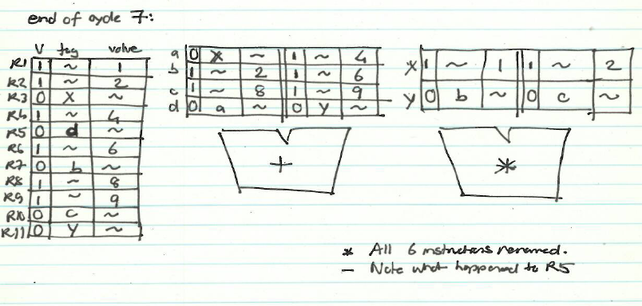
State of RAT and RS in Cycle 7

Slide 57
State of RAT and RS in Cycle 7
Cycle
1
2
3
4
5
6
7
MUL | R1, R2 | → | R3
ADD | R3, R4 | → | R5
ADD | R2, R6 | → | R7
ADD | R8, R9 | → | R10
MUL | R7, R10 | → | R11
ADD | R5, R11 | → | R5
F
D
E₁
E₂
E₃
E₄
E₅
F
D
-
-
-
-
F
D
E₁
E₂
E₃
F
D
E₁
E₂
F
D
-
F
D
Register | Valid | Tag | Value
R1 | 1 |  | 1
R2 | 1 |  | 2
R3 | 0 | x
R4 | 1 |  | 4
R5 | 0 | a
R6 | 1 |  | 6
R7 | 0 | b
R8 | 1 |  | 8
R9 | 1 |  | 9
R10 | 0 | c
R11 | 0 | y
 | Source 1 |  |  | Source 2
 | V | Tag | Value | V | Tag | Value
a | 0 | x |  | 1 | ~ | 4
b | 1 | ~ | 2 | 1 | ~ | 6
c | 1 | ~ | 8 | 1 | ~ | 9
d
 | Source 1 |  |  | Source 2
 | V | Tag | Value | V | Tag | Value
x | 1 | ~ | 1 | 1 | ~ | 2
y | 0 | b |  | 0 | c
z
t
0
d
0
a
0
y
+
∗

Slide 58
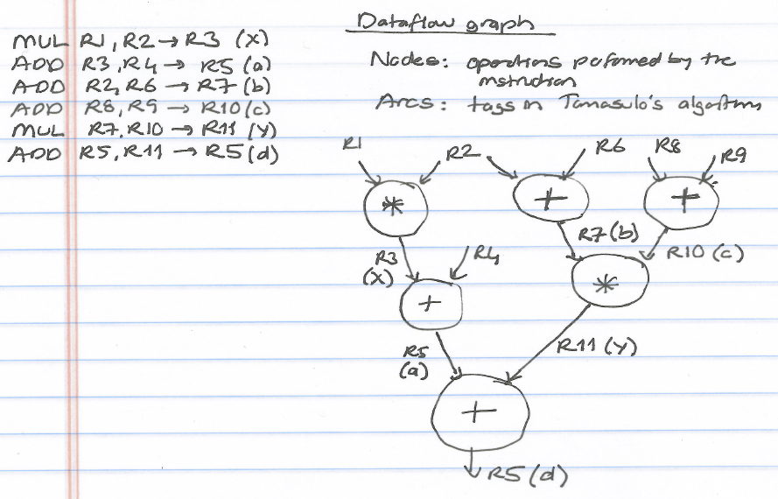
Corresponding Dataflow Graph (Reverse Engineered)

Slide 59
Some More Questions (Design Choices)
When is a reservation station entry deallocated?
Exactly when does an instruction broadcast its tag?
Should the reservation stations be dedicated to each functional unit or global across functional units?
Centralized vs. Distributed: What are the tradeoffs?
Should reservation stations and ROB store data values or should there be a centralized physical register file where all data values are stored?
What are the tradeoffs?
Many other design choices for OoO engines

Slide 60
For You: An Exercise, w/ Precise Exceptions
Assume ADD (4 cycle execute), MUL (6 cycle execute)
Assume one adder and one multiplier
How many cycles
in a non-pipelined machine
in an in-order-dispatch pipelined machine with reorder buffer (no forwarding and full forwarding)
in an out-of-order dispatch pipelined machine with reorder buffer (full forwarding)
MUL R3 ← R1, R2
ADD R5 ← R3, R4
ADD R7 ← R2, R6
ADD R10 ← R8, R9
MUL R11 ← R7, R10
ADD R5 ← R5, R11
F
D
E
R
W

Slide 61
Out-of-Order Execution with Precise Exceptions
Idea: Use a reorder buffer to reorder instructions before committing them to architectural state
An instruction updates the RAT when it completes execution
Also called frontend register file
An instruction updates a separate architectural register file when it retires
i.e., when it is the oldest in the machine and has completed execution
In other words, the architectural register file is always updated in program order
On an exception: flush pipeline, copy architectural register file into frontend register file

Slide 62
Out-of-Order Execution with Precise Exceptions
Hump 1: Reservation stations (scheduling window)
Hump 2: Reordering (reorder buffer, aka instruction window or active window)
TAG and VALUE Broadcast Bus
S
C
H
E
D
U
L
E
R
E
O
R
D
E
R
E
Integer add
Integer mul
F
D
E
E
E
E
W
FP mul
E
E
E
E
E
E
E
E
. . .
E
E
E
E
E
E
E
E
Load/store
in order
out of order
in order

Slide 63
Two Humps in a Modern Pipeline
Hump 1: Reservation stations (scheduling window)
Hump 2: Reordering (reorder buffer, aka instruction window or active window)
TAG and VALUE Broadcast Bus
S
C
H
E
D
U
L
E
R
E
O
R
D
E
R
E
Integer add
Integer mul
F
D
E
E
E
E
W
FP mul
E
E
E
E
E
E
E
E
. . .
E
E
E
E
E
E
E
E
Load/store
in order
out of order
in order
Photo credit: http://true-wildlife.blogspot.ch/2010/10/bactrian-camel.html

Slide 64
Modern OoO Execution w/ Precise Exceptions
Most modern processors use the following
Reorder buffer to support in-order retirement of instructions
A single register file to store all registers
Both speculative and architectural registers
INT and FP are still separate
Two register maps
Future/frontend register map → used for renaming
Architectural register map → used for maintaining precise state

Slide 65
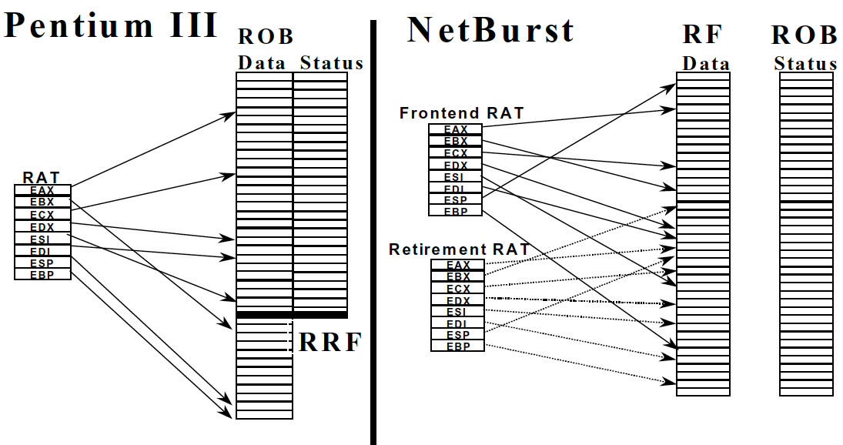
An Example from Modern Processors
Boggs et al., “The Microarchitecture of the Pentium 4 Processor,” Intel Technology Journal, 2001.

Slide 66
Enabling OoO Execution, Revisited
1. Link the consumer of a value to the producer
Register renaming: Associate a “tag” with each data value
2. Buffer instructions until they are ready
Insert instruction into reservation stations after renaming
3. Keep track of readiness of source values of an instruction
Broadcast the “tag” when the value is produced
Instructions compare their “source tags” to the broadcast tag → if match, source value becomes ready
4. When all source values of an instruction are ready, dispatch the instruction to functional unit (FU)
Wakeup and select/schedule the instruction

Slide 67
Summary of OOO Execution Concepts
Register renaming eliminates false dependencies, enables linking of producer to consumers
Buffering enables the pipeline to move for independent ops
Tag broadcast enables communication (of readiness of produced value) between instructions
Wakeup and select enables out-of-order dispatch

Slide 68
OOO Execution: Restricted Dataflow
An out-of-order engine dynamically builds the dataflow graph of a piece of the program
which piece?
The dataflow graph is limited to the instruction window
Instruction window: all decoded but not yet retired instructions
Can we do it for the whole program?
Why would we like to?
In other words, how can we have a large instruction window?
Can we do it efficiently with Tomasulo’s algorithm?

Slide 69
Recall: Dataflow Graph for Our Example
MUL R3 ← R1, R2
ADD R5 ← R3, R4
ADD R7 ← R2, R6
ADD R10 ← R8, R9
MUL R11 ← R7, R10
ADD R5 ← R5, R11

Slide 70
Recall: State of RAT and RS in Cycle 7

Slide 71
Recall: Dataflow Graph

Slide 72
Questions to Ponder
Why is OoO execution beneficial?
What if all operations take a single cycle?
Latency tolerance: OoO execution tolerates the latency of multi-cycle operations by executing independent operations concurrently
What if an instruction takes 500 cycles?
How large of an instruction window do we need to continue decoding?
How many cycles of latency can OoO tolerate?
What limits the latency tolerance scalability of Tomasulo’s algorithm?
Active/instruction window size: determined by both scheduling window and reorder buffer size

Slide 73
General Organization of an OOO Processor
Smith and Sohi, “The Microarchitecture of Superscalar Processors,” Proc. IEEE, Dec. 1995.

Slide 74
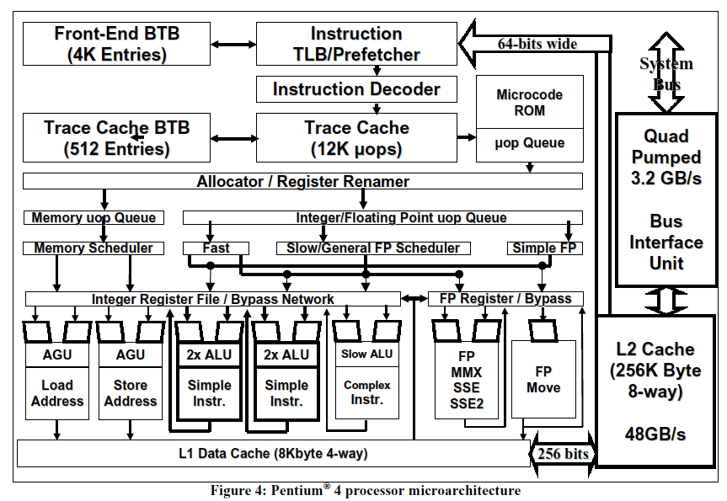
A Modern OoO Design: Intel Pentium 4
Boggs et al., “The Microarchitecture of the Pentium 4 Processor,” Intel Technology Journal, 2001.

Slide 75
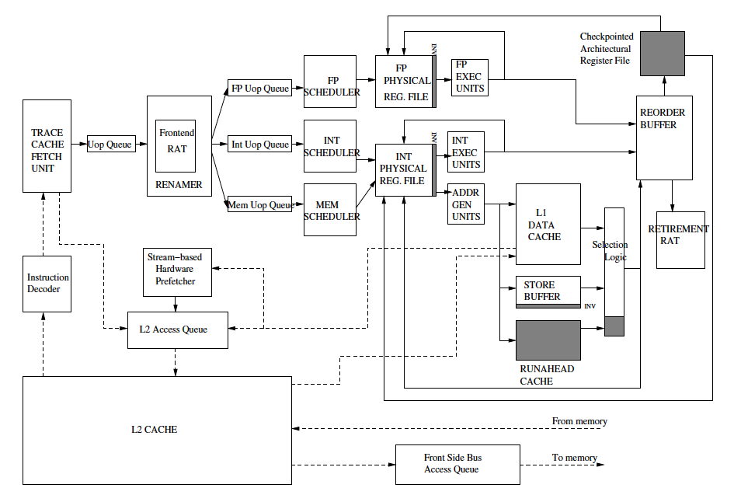
Intel Pentium 4 Simplified
Mutlu+, “Runahead Execution,”
HPCA 2003.

Slide 76
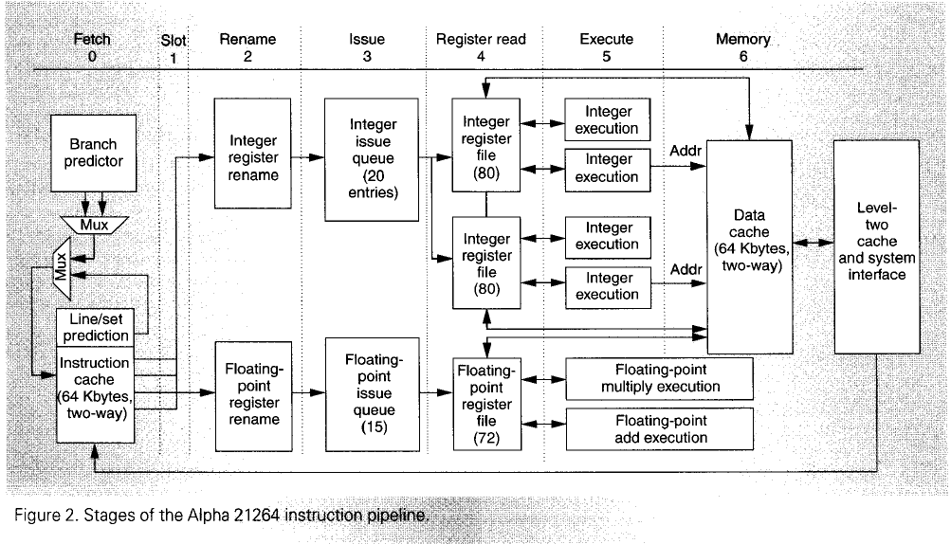
Alpha 21264
Kessler, “The Alpha 21264 Microprocessor,” IEEE Micro, March-April 1999.

Slide 77
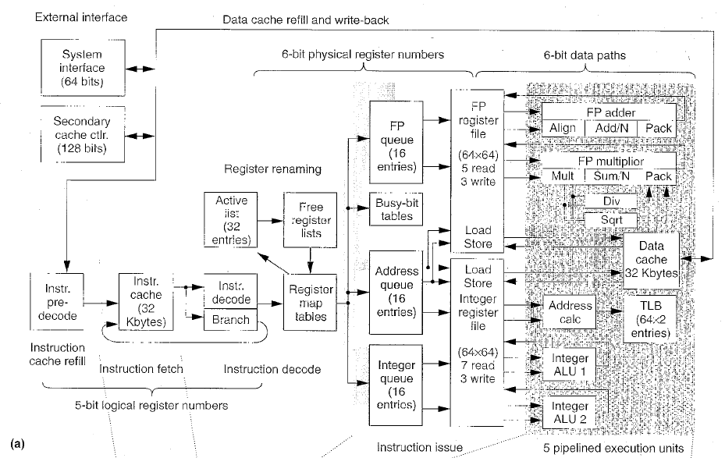
MIPS R10000
Yeager, “The MIPS R10000 Superscalar Microprocessor,” IEEE Micro, April 1996

Slide 78
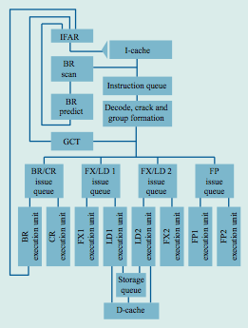
IBM POWER4
Tendler et al., “POWER4 system microarchitecture,” IBM J R&D, 2002.

Slide 79
IBM POWER4
2 cores, out-of-order execution
100-entry instruction window in each core
8-wide instruction fetch, issue, execute
Large, local+global hybrid branch predictor
1.5MB, 8-way L2 cache
Aggressive stream based prefetching

Slide 80
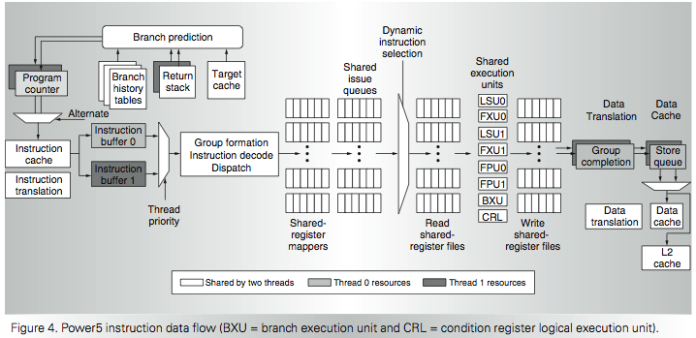
IBM POWER5
Kalla et al., “IBM Power5 Chip: A Dual-Core Multithreaded Processor,” IEEE Micro 2004.

Slide 81
Handling Out-of-Order Execution of Loads and Stores

Slide 82
Registers versus Memory
So far, we considered mainly registers as part of state
What about memory?
What are the fundamental differences between registers and memory?
Register dependences known statically – memory dependences determined dynamically
Register state is small – memory state is large
Register state is not visible to other threads/processors – memory state is shared between threads/processors (in a shared memory multiprocessor)

Slide 83
Memory Dependence Handling (I)
Need to obey memory dependences in an out-of-order machine
and need to do so while providing high performance
Observation and Problem: Memory address is not known until a load/store executes
Corollary 1: Renaming memory addresses is difficult
Corollary 2: Determining dependence or independence of loads/stores need to be handled after their (partial) execution
Corollary 3: When a load/store has its address ready, there may be younger/older loads/stores with undetermined addresses in the machine

Slide 84
Memory Dependence Handling (II)
When do you schedule a load instruction in an OOO engine?
Problem: A younger load can have its address ready before an older store’s address is known
Known as the memory disambiguation problem or the unknown address problem
Approaches
Conservative: Stall the load until all previous stores have computed their addresses (or even retired from the machine)
Aggressive: Assume load is independent of unknown-address stores and schedule the load right away
Intelligent: Predict (with a more sophisticated predictor) if the load is dependent on the/any unknown address store

Slide 85
Handling of Store-Load Dependences
A load’s dependence status is not known until all previous store addresses are available.
How does the OOO engine detect dependence of a load instruction on a previous store?
Option 1: Wait until all previous stores committed (no need to check for address match)
Option 2: Keep a list of pending stores in a store buffer and check whether load address matches a previous store address
How does the OOO engine treat the scheduling of a load instruction wrt previous stores?
Option 1: Assume load dependent on all previous stores
Option 2: Assume load independent of all previous stores
Option 3: Predict the dependence of a load on an outstanding store

Slide 86
Memory Disambiguation (I)
Option 1: Assume load is dependent on all previous stores
+ No need for recovery
-- Too conservative: delays independent loads unnecessarily
Option 2: Assume load is independent of all previous stores
+ Simple and can be common case: no delay for independent loads
-- Requires recovery and re-execution of load and dependents on misprediction
Option 3: Predict the dependence of a load on an outstanding store
+ More accurate. Load store dependencies persist over time
-- Still requires recovery/re-execution on misprediction
Alpha 21264 : Initially assume load independent, delay loads found to be dependent
Moshovos et al., “Dynamic speculation and synchronization of data dependences,” ISCA 1997.
Chrysos and Emer, “Memory Dependence Prediction Using Store Sets,” ISCA 1998.

Slide 87
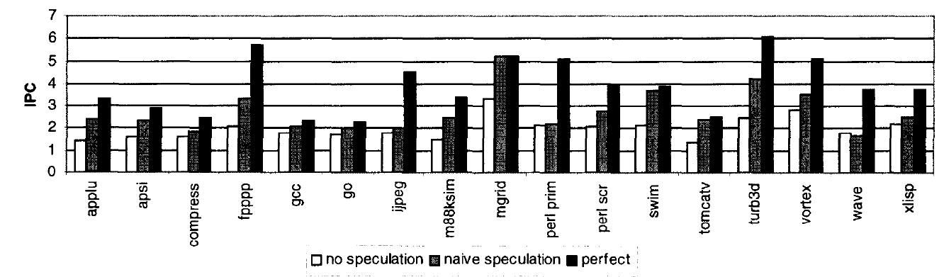
Memory Disambiguation (II)
Chrysos and Emer, “Memory Dependence Prediction Using Store Sets,” ISCA 1998.
Predicting store-load dependencies important for performance
Simple predictors (based on past history) can achieve most of the potential performance

Slide 88
Data Forwarding Between Stores and Loads
We cannot update memory out of program order
→ Need to buffer all store and load instructions in instruction window
Even if we know all addresses of past stores when we generate the address of a load, two questions still remain:
1. How do we check whether or not it is dependent on a store
2. How do we forward data to the load if it is dependent on a store
Modern processors use a LQ (load queue) and an SQ for this
Can be combined or separate between loads and stores
A load searches the SQ after it computes its address. Why?
A store searches the LQ after it computes its address. Why?

Slide 89
Out-of-Order Completion of Memory Ops
When a store instruction finishes execution, it writes its address and data in its reorder buffer entry
When a later load instruction generates its address, it:
searches the reorder buffer (or the SQ) with its address
accesses memory with its address
receives the value from the youngest older instruction that wrote to that address (either from ROB or memory)
This is a complicated “search logic” implemented as a Content Addressable Memory
Content is “memory address” (but also need size and age)
Called store-to-load forwarding logic

Slide 90
Store-Load Forwarding Complexity
Content Addressable Search (based on Load Address)
Range Search (based on Address and Size of both the Load and earlier Stores)
Age-Based Search (for last written values)
Load data can come from a combination of multiple places
One or more stores in the Store Buffer (SQ)
Memory/cache

Slide 91
Other Approaches to Concurrency (or Instruction Level Parallelism)

Slide 92
Approaches to (Instruction-Level) Concurrency
Pipelining
Out-of-order execution
Dataflow (at the ISA level)
Superscalar Execution
VLIW
Fine-Grained Multithreading
SIMD Processing (Vector and array processors, GPUs)
Decoupled Access Execute
Systolic Arrays

Slide 93
Review: Data Flow: Exploiting Irregular Parallelism

Slide 94
Data Flow Summary
Availability of data determines order of execution
A data flow node fires when its sources are ready
Programs represented as data flow graphs (of nodes)
Data Flow at the ISA level has not been (as) successful
Data Flow implementations under the hood (while preserving sequential ISA semantics) have been very successful
Out of order execution is the prime example

Slide 95
Pure Data Flow Advantages/Disadvantages
Advantages
Very good at exploiting irregular parallelism
Only real dependencies constrain processing
More parallelism can be exposed than von Neumann model
Disadvantages
No precise state semantics
Debugging very difficult
Interrupt/exception handling is difficult (what is precise state semantics?)
Too much parallelism? (Parallelism control needed)
High bookkeeping overhead (tag matching, data storage)
…

Slide 96
Approaches to (Instruction-Level) Concurrency
Pipelining
Out-of-order execution
Dataflow (at the ISA level)
Superscalar Execution
VLIW
Fine-Grained Multithreading
SIMD Processing (Vector and array processors, GPUs)
Decoupled Access Execute
Systolic Arrays

Slide 97
Superscalar Execution

Slide 98
Superscalar Execution
Idea: Fetch, decode, execute, retire multiple instructions per cycle
N-wide superscalar → N instructions per cycle
Need to add the hardware resources for doing so
Hardware performs the dependence checking between concurrently-fetched instructions
Superscalar execution and out-of-order execution are orthogonal concepts
Can have all four combinations of processors:
[in-order, out-of-order] x [scalar, superscalar]

Slide 99
In-Order Superscalar Processor Example
Multiple copies of datapath: Can issue multiple instructions at per cycle
Dependencies make it tricky to issue multiple instructions at once
Here: Ideal IPC = 2

Slide 100
In-Order Superscalar Performance Example
lw $t0, 40($s0)
add $t1, $s1, $s2
sub $t2, $s1, $s3 and $t3, $s3, $s4 or $t4, $s1, $s5
sw $s5, 80($s0)
Ideal IPC = 2
Actual IPC = 2 (6 instructions issued in 3 cycles)

Slide 101
Superscalar Performance with Dependencies
lw $t0, 40($s0)
add $t1, $t0, $s1
sub $t0, $s2, $s3 and $t2, $s4, $t0 or $t3, $s5, $s6
sw $s7, 80($t3)
Ideal IPC = 2
Actual IPC = 1.2 (6 instructions issued in 5 cycles)

Slide 102
Superscalar Tradeoffs
Advantages
Higher IPC (instructions per cycle)
Disadvantages
Higher complexity for dependency checking
Require checking within a pipeline stage
Renaming becomes more complex in an OoO processor
More hardware resources needed

